Slide 1
Web Frontend Development CSS color
ZhuHua

Slide 2
Foreground Color
Color can really bring your pages to life
The color property allows you to specify the color of text inside an element. You can specify any color in CSS in one of three ways:
rgb values These express colors in terms of how much red, green and blue are used to make it up. For example: rgb(100,100,90)
hex codes These are six-digit codes that represent the amount of red, green and blue in a color, preceded by a pound or hash # sign. For example: #ee3e80
color names There are 147 predefined color names that are recognized by browsers. For example: DarkCyan

Slide 3
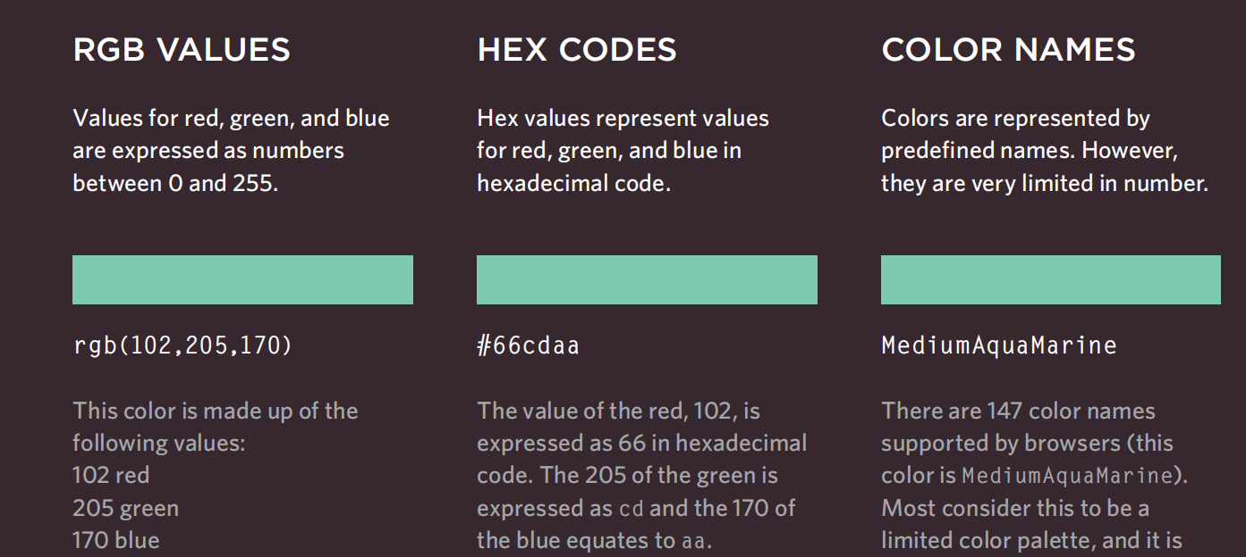
Color value

Slide 4
background-color
CSS treats each HTML element as if it appears in a box, and the background-color property sets the color of the background for that box.
You can specify your choice of background color in the same three ways you can specify foreground colors: RGB values, hex codes, and color names
By default, most browser windows have a white background, but browser users can set a background color for their windows, so if you want to be sure that the background is white you can use the background-color property on the <body> element.

Slide 5
Understanding Color
Every color on a computer screen is created by mixing amounts of red, green, and blue. To find the color you want, you can use a color picker.
Computer monitors are made up of thousands of tiny squares called pixels (if you look very closely at your monitor you should be able to see them).
When the screen is not turned on, it's black because it's not emitting any light. When it's on, each pixel can be a different color, creating a picture.
The color of every pixel on the screen is expressed in terms of a mix of red, green, and blue — just like on a television screen.

Slide 6
opacity, rgba
CSS3 introduces the opacity property which allows you to specify the opacity of an element and any of its child elements. The value is a number between 0.0 and 1.0 (so a value of 0.5 is 50% opacity and 0.15 is 15% opacity).
The CSS3 rgba property allows you to specify a color, just like you would with an RGB value, but adds a fourth value to indicate opacity. This value is known as an alpha value and is a number between 0.0 and 1.0 (so a value of 0.5 is 50% opacity and 0.15 is 15% opacity). The rgba value will only affect the element on which it is applied (not child elements).

Slide 7
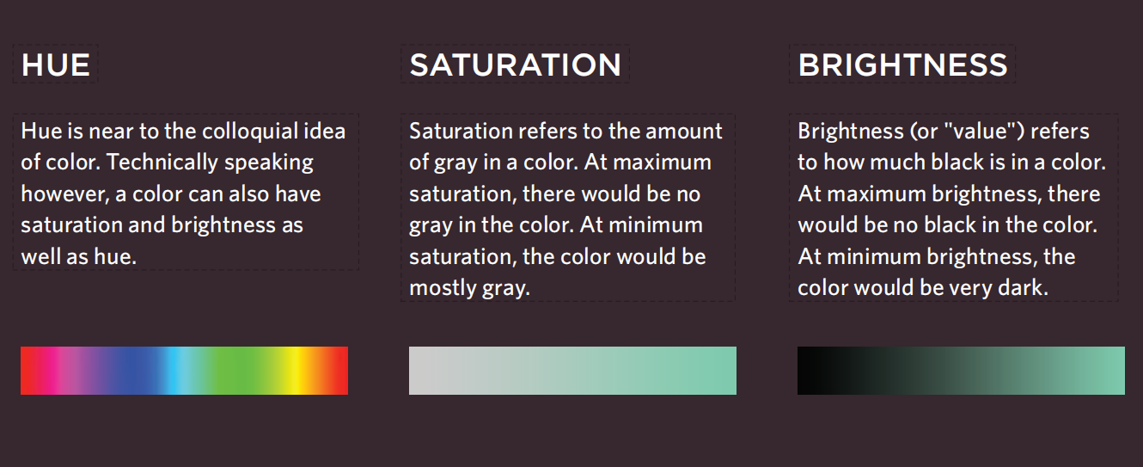
Css3: hsl Colors
CSS3 introduces an entirely new and intuitive way to specify colors using hue, saturation, and lightness values.

Slide 8
Css3: hsl&hsla
The hsl color property has been introduced in CSS3 as an alternative way to specify colors.
The value of the property starts with the letters hsl, followed by individual values inside parentheses for:
hue This is expressed as an angle (between 0 and 360 degrees). percentage.
lightness This is expressed as a percentage with 0% being white, 50% being normal, and 100% being black.
The hsla color property allows you to specify color properties using hue, saturation, and lightness as above, and adds a fourth value which represents transparency (just like the rgba property).
background-color: hsla(0,100%,100%,0.5);

Slide 9
Summary
Color not only brings your site to life, but also helps convey the mood and evokes reactions.
There are three ways to specify colors in CSS: RGB values, hex codes, and color names.
Color pickers can help you find the color you want.
It is important to ensure that there is enough contrast between any text and the background color (otherwise people will not be able to read your content).
CSS3 has introduced an extra value for RGB colors to indicate opacity. It is known as RGBA.
CSS3 also allows you to specify colors as HSL values, with an optional opacity value. It is known as HSLA.

Slide 10
Questions？
Which of the following is a predefined color name in CSS?
RedGreenBlue
blue
RGB
HEX

Slide 11
Questions？
Which of the following is a predefined color name in CSS?
RedGreenBlue
blue
RGB
HEX

Slide 12
Questions？
What is the correct syntax to set a background color in CSS?
background-clr: color;
bg-color: red;
background-color: blue;
color-background: blue;

Slide 13
Questions？
What is the correct syntax to set a background color in CSS?
background-clr: color;
bg-color: red;
background-color: blue;
color-background: blue;

